Slide 1
Grainger – SVOT & Tenancy Review
SteerCo Update
30th July 2025

Slide 2
Project Overview
Revised RAID Log
Revised Project Objectives
Project Timeline
Demo
Cutover Plan
Single View of Customer
Roadmap
Q&A

Slide 3
Project Overview
This project will deliver a bespoke tenancy review journey within Salesforce that is efficient, improves visibility into supporting information, maintains a full history of associated activity, and provides an improved customer experience.
Given the timing of the project, the process is designed to align with the upcoming Renters’ Rights Bill.
In order ensure complete and accurate tenancy data is driving the tenancy review process, a foundational release will create a single view of tenancy within Salesforce that is aligned with Qube, as the system of record for tenancy data.

Slide 4
Revised RAID Log
Risks, Assumptions, Issues & Decisions
Category | Description | Impact | Decision
Assumption Issue | Renters’ Rights Bill was expected to come into effect between Sept 2025 and Jan 2026. | Functionality designed for Renters’ Rights will go live before the legislation comes into effect. | Grainger to move any tenancies that come up for renewal to periodic after Sept go-live, issuing existing S13 documents. Grainger to keep tenancies that come up for renewal on fixed term contracts until RRB live. New functionality needed to be modified to accommodate continuation of fixed-term ASTs.
Risk Decision | Details of Renters’ Rights Bill not finalised until after go-live. | Functionality will generate current documents | Enhancements & new document templates to be implemented after go-live.
Decision | Process to manage S13 formal challenges will be addressed as a separate project. | Additional development may be required & the new process may not be available day 1 when legislation comes into effect. | Existing process to manage formal challenges to continue in the interim. New process to be confirmed once legislation is finalised.

Slide 5



Revised Project Objectives
Tenancy Review Process
Reliable Platform for Collaboration
Single source of truth.
Replace the offline renewal spreadsheets.
Replace the existing, unreliable tenant portal for renewal offers.
Prepopulate Inputs to the Tenancy Review Process
Remove the need to cross-check information between Excel spreadsheets, Salesforce and Qube.
Eliminate manual input of Price Book Rent & ERVs.
Provide latest tenancy arrears balances & rent within Salesforce.
Align with
Lay the Groundwork for
the Renters’ Rights Bill
Generate new Section 13 notices.
Allow for fixed term tenancies to continue while minimising the changes required when Renters’ Rights comes into effect.
Highlight tenancy reviews at risk of missing deadlines.

Slide 6
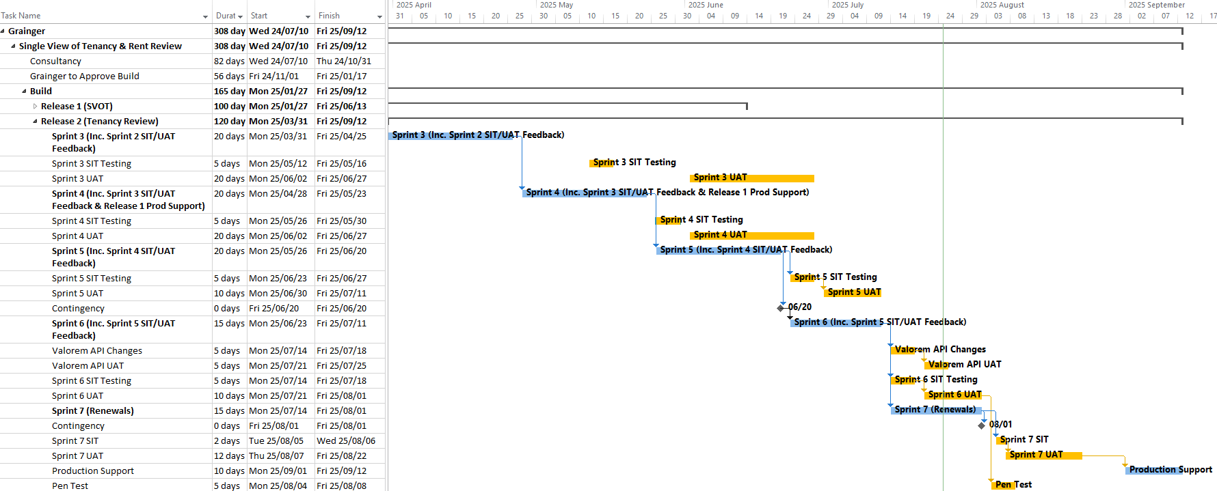

Timeline
Release 2 Go-Live

Slide 7
Demo

Slide 8

Cutover
September 2025 October 2025 November 2025 December 2025 January 2026
Existing Renewal Process
PM & AM Review
Offer & Negotiation
Send
Documents
Update Qube
November
Rent Increases
December Renewals Created
[90 days prior]
PM & AM Review
Offer & Negotiation
Send
Documents
Update
Qube
December
Rent Increases
Turn Off
Renewal Creation
3
Oct
New Tenancy Review Process
Go Live
Turn on Tenancy Review Creation
Jan
TRs
AM Review
Offer & Negotiation
Send Documents
Update
Qube
January
Rent Increases
1
Sep
10 Sep
11 Sep
9
Oct
30
Oct
February Tenancy Reviews Created [21 weeks prior]
AM Review
Offer & Negotiation
Send Documents
Update
Qube
12 Oct
9
Nov
30
Nov

Slide 9














Single View of Customer
Account Contact Details
Information One Click Away within Salesforce
Opportunities
Right to Rent
Customer
Contracts
Communications
Tenancies
Future visibility in Salesforce
Unit
End of Tenancy
Arrears History
Maintenance
Complaints, Grumbles & Incidents
Notes:
Visual representation of SVOC
Simplified data model on one slide
Emphasize all information is one click away.

Slide 10
Roadmap
Future Outcomes for Tenancy Reviews & SVOC
Renters’ Rights Bill
Add/update S13 & new lease documents
Update tenancy review notification email & Form Assembly wording.
Minor enhancements to tenancy review opportunities.
New lease process enhancements
Single View of Commercial Tenancies
Online
Change of Sharer Forms
Renters’ Rights Bill
Case Management for Formal Challenges
Rent Collection & Arrears Management
Notes:
Future outcomes on the Salesforce roadmap for development:
Renters’ Rights Bill
Case Management for Formal Challenges
Rent Collection & Arrears Management
Streamlined Change of Sharer Process
SVOT for Commercial Tenancies
Omni-channel & WhatsApp Integration

Slide 11
Any Questions?

Slide 12
Thank You

Slide 13

Appendix

Slide 14



Objectives
Single View of Tenancy
Create the Concept of a Tenancy in Salesforce
Align Salesforce & Qube tenancy data models.
Map Salesforce tenancies directly to Qube tenancies.
Foundation to simplify future integrations.
Provide Single View of Tenancy
Provide a single view of all tenants & related parties, associated opportunities, and contracts within Salesforce.
Link related tenancies.
Data Accuracy & Completeness
Visibility into all current residential tenancies in Salesforce.
Maintain an accurate record in Salesforce of which tenancies and tenants are current & who has vacated.
Trusted data from which tenancy review opportunities may be reliably created.

